Slide 1
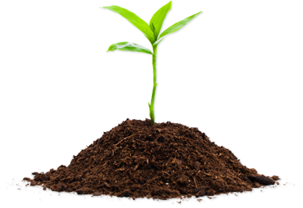
Conceptual Phase Briefing
September — 2017
Smart
Environment
Khmelnytskyi
City of Khmelnytskyi, Ukraine — Municipal Solid Waste Program
Notes:
The City of Khmelnytskyi is now in the conceptual phase of a significant project to reform its municipal solid waste management program. We hope this project will serve as a model to other cities across Ukraine.

Slide 2
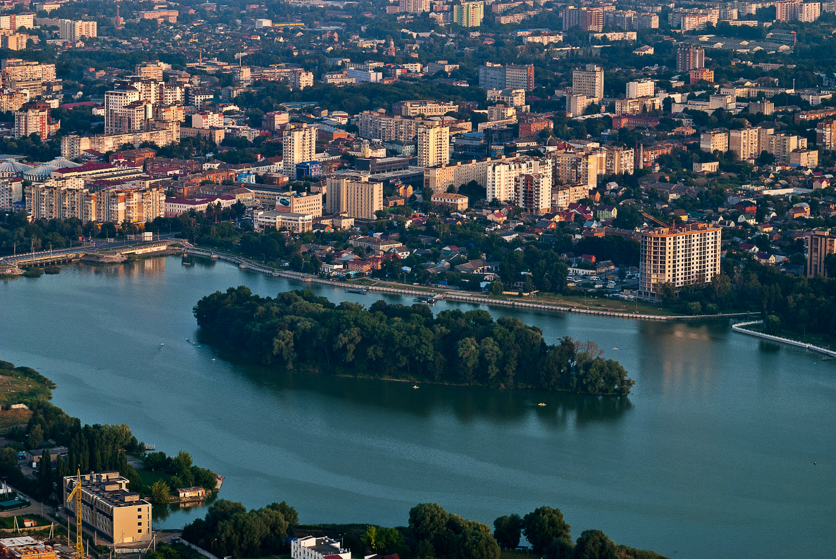
Notes:
Khmelnytskyi is a
growing city of 265,000 people and the
capital city of Khmelytskyi Oblast.
We are well-known for our apparel market, but we would like to think of our city as a
Marketplace of Innovation and Opportunity.

Slide 3
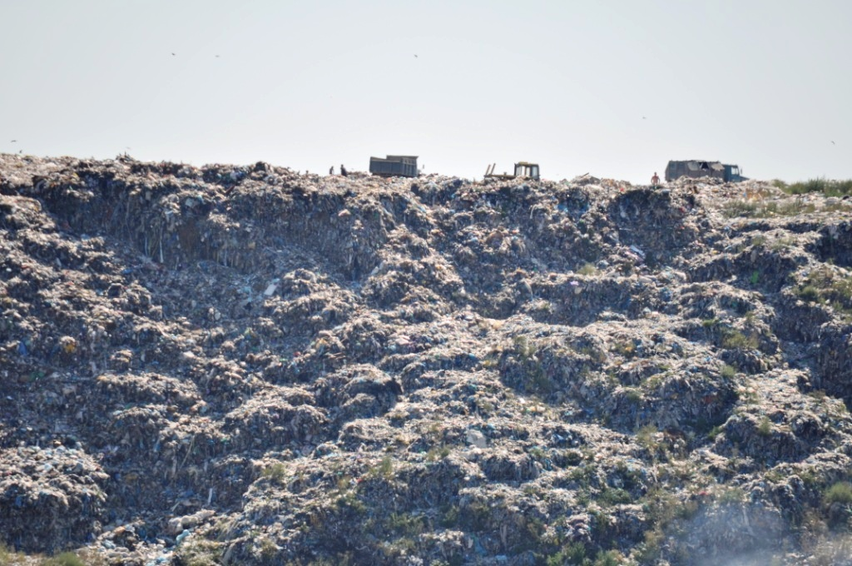
Notes:
Like so many other cities in Ukraine, we are seriously concerned municipal solid waste.
The current landfill is
60 years old,
An environmental hazard
And, at current rates, can accept trash from just another 5-6 years.
Citizens and elected leadership are concerned and there is a growing sense of urgency.

Slide 4
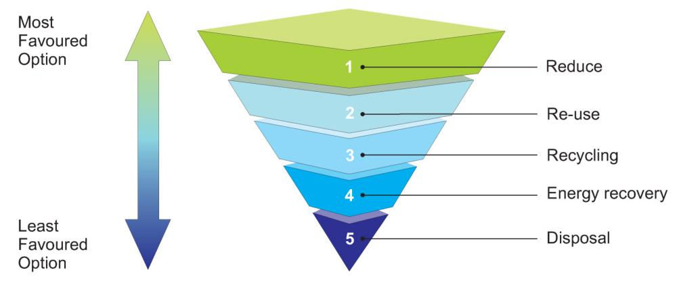
Khmelnytskyi wants to adopt higher standards, consisted with Ukraine’s commitment to transpose current law to meet European requirements as described in the draft Changing Our Behavior — A Municipal Waste Strategy for Ukraine.
Notes:
Khmelnytskyi city leaders want to adopt high standards for treatment of municipal solid waste. Standards that are environmentally sustainable, economically feasible and consistent with Ukrainian law.
These standards are described in draft regulatory documents now under development in Ukraine. At the heart of the reform is the concept of the Waste Hierarchy.
This hierarchy of waste management options describes the most desirable option as not producing waste in the first place and the least desirable option is to dispose of waste in a landfill with no recovery of materials or energy.
Waste should be reused, recycled and energy recovered before being disposed.

Slide 5
We already produce less
Молодець,
Khmelnytskyi!
Notes:
To address the issue, we started by gathering data on the amount currently being disposed, as well as content. We installed a scale at the entrance to the landfill and we’ve started an ongoing program to determine waste content.
We found that we produce about 90,000 tons of municipal solid waste annually and about half of that is organic materials.
The frugal people in Khmelnytskyi produce less than 1 kg per person per day of trash. Far less than their friends in Europe or the US.

Slide 6
Lots of potato peels
Notes:
Our content analysis found a high percentage of organic waste: potato peels and beet root scraps from grandma’s kitchen. Over 45 percent of our waste is organic.

Slide 7
We are running out of time and space
Notes:
At our current rate, the landfill will no longer be able to accept waste in 5-6 years. Sorting of plastic and other materials would have only a minor impact – perhaps an additional 6 months.
It is unlikely that city residents and businesses will further reduce the amount of waste they produce. It is already low and greater economic development usually brings about greater waste per capita.
In order to make the landfill last longer, we will have to divert a much higher percentage of waste.
Note: Chart assumes 90,000 tons per year, with diversion starting in 2020. Also assumes we currently have 6 years remaining.

Slide 8
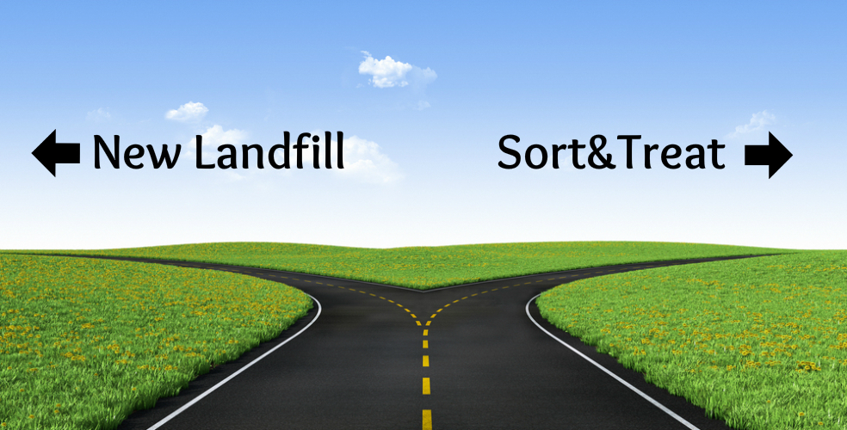
Notes:
Our options are clear: get a new landfill or make the old one last.
However, there is simply no practical way to open a new landfill. There is no available site of adequate size that fits the criteria established by Ukrainian law.
Further, if a site was available, the costs of a sanitary landfill are high – perhaps $70 per ton.

Slide 9
Our Goal:
Reduce the waste to landfill by at least 85 percent. Extend the life of the landfill by 20-25 years.
Notes:
With no new sites available, not to mention costs and new standards, we chose to extend the life of the current landfill by diverting at least 85 percent of the waste.
By reaching this target, the landfill will have adequate capacity for another 20-25 years.
Our next issue was HOW to do this?

Slide 10
Notes:
We evaluated a number of options on how this might be accomplished keeping in mind the amount and type of waste we generate, as well as the ability of residents to accept higher collection and treatment fees.
We needed a relatively simple, proven and environmentally friendly technology with
low capital costs
low operating costs
high rate of separation
With the ability to generate fuel for district heating.

Slide 11
Our Preferred Method:
Sterilization of mixed municipal solid waste followed by mechanical separation.
Notes:
After an extensive review and after touring a number of plants in neighboring countries, we believe that sterilization, followed by mechanical separation, is the best option for us.

Slide 12
Our plan — Smart Environment Khmelnytskyi, has two parts:
Notes:
We’ve developed a plan we call “Smart Environment Khmelnytskyi”. This plan has two components.

Slide 13
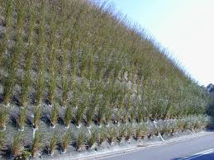
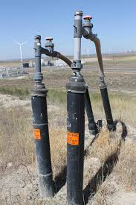
1— Extract landfill gas, stabilize and cap slopes, generate renewable energy
Notes:
The first step is to address the environmental hazards of the landfill.
Through a public/private partnership, we will extract biogas through wells sunk into the landfill. The gas will be collected and used to fuel generators that create electricity.
Earnings from the partnership will be used to stabilize, cap and restore the unused portions of the landfill. This will control emissions, reduce leachate, reduce fire risk and control birds, vermin and other vectors.
We are currently searching for a qualified engineer to prepare a plan for stabilization.

Slide 14
2— Construct a Sterilization Mechanical Treatment Plant The purpose of this plant is to sterilize mixed municipal solid waste, sort out recyclables and produce biomass and RDF.
Notes:
The second component of the plan is to construct a sterilization and mechanical treatment or SMT plant. A five-hectare site has been near the landfill has been identified and negotiations for purchase are underway.
This plant is fully enclosed, with negative air pressure.

Slide 15
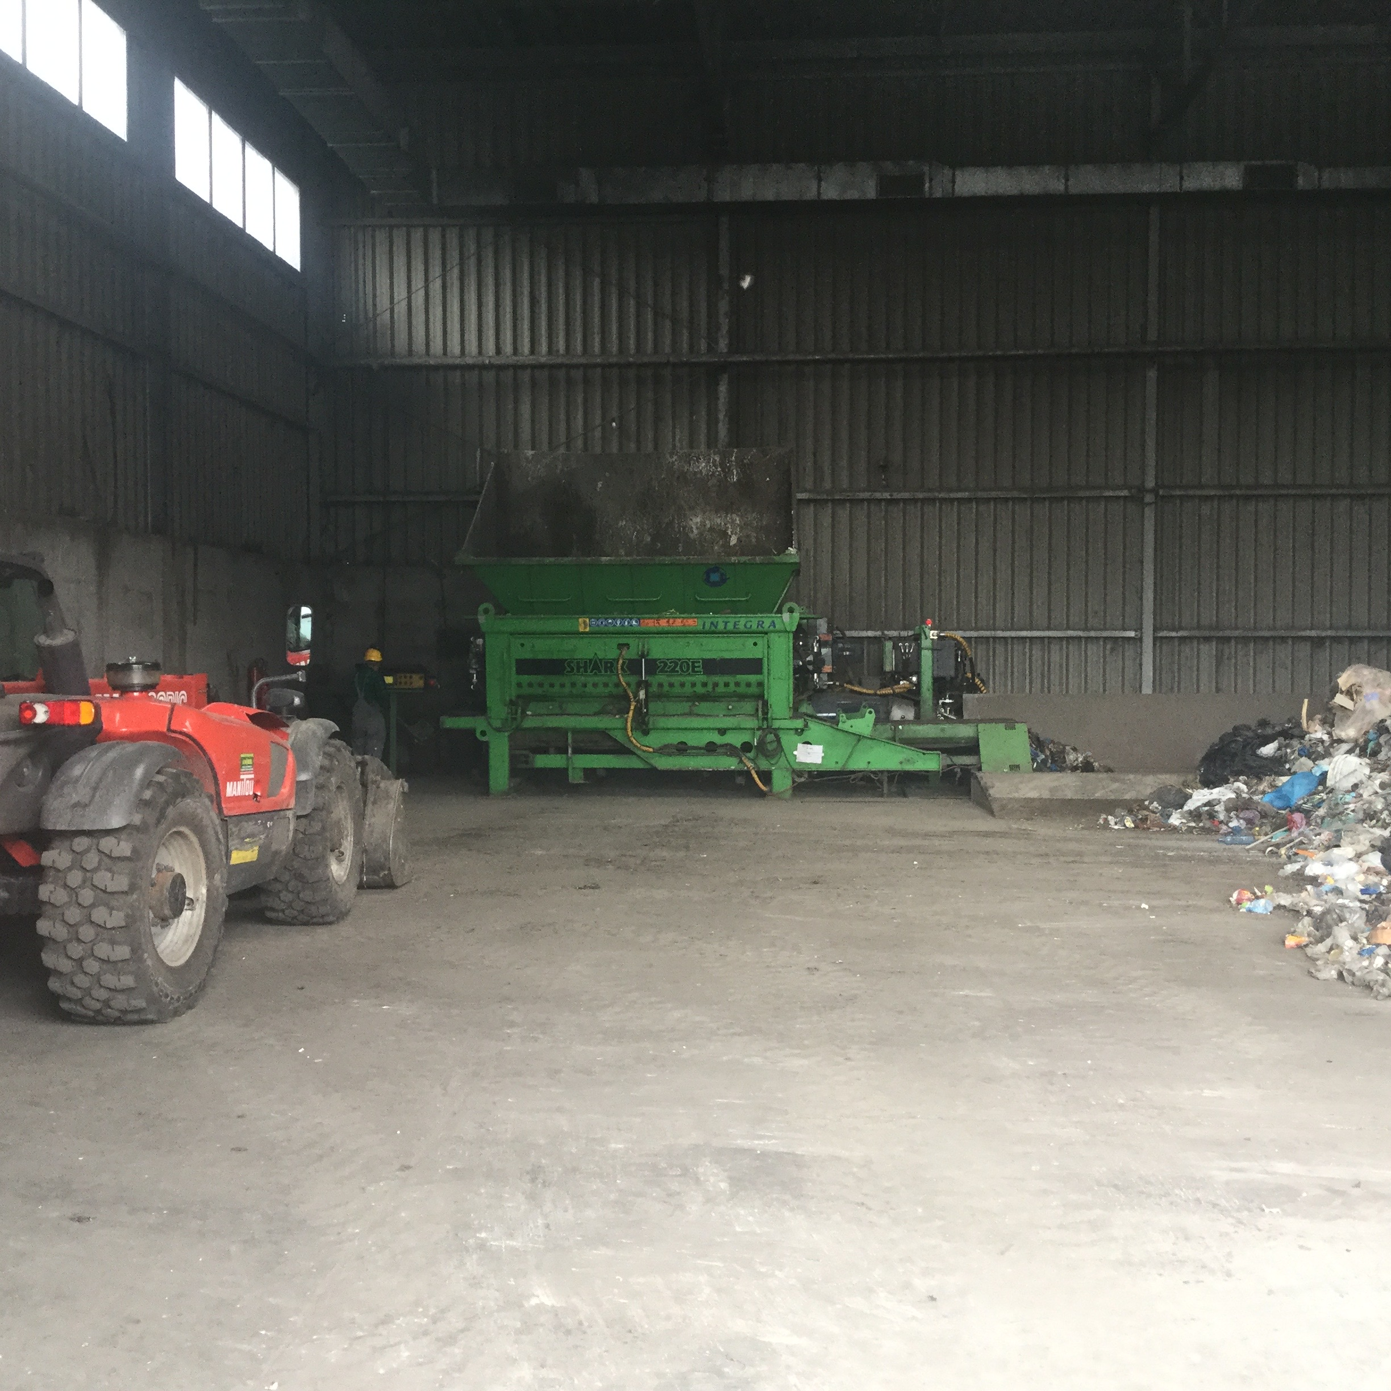
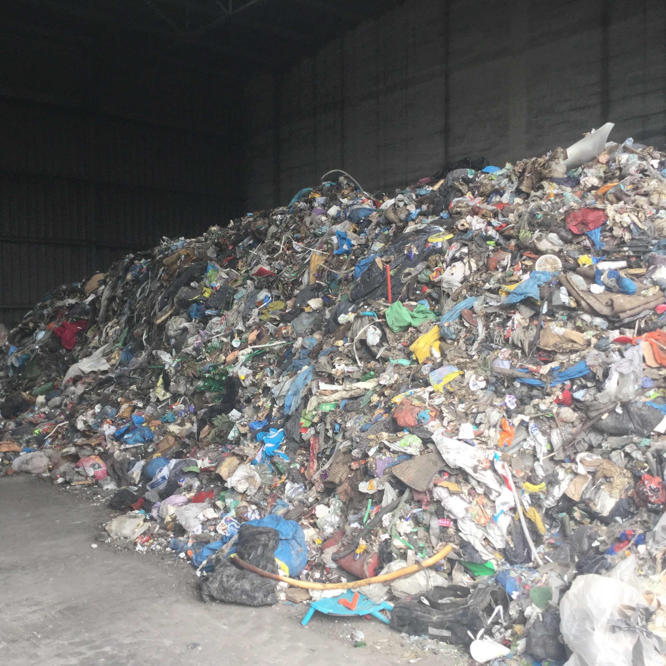
Mixed Municipal Solid Waste is brought to the tipping floor, bulky and unusual items removed and the waste is placed into a 50 cm shredder.
Notes:
Because the waste is treated within hours of being received, there is virtually no odor or need for expensive filters and odor emission equipment.
Soon after being placed on the tipping floor, waste is placed in a shredder that reduces the size of each piece to no more than 50 centimeters. Once shredded, the waste moved on a conveyor belt to another room for sterilization.

Slide 16
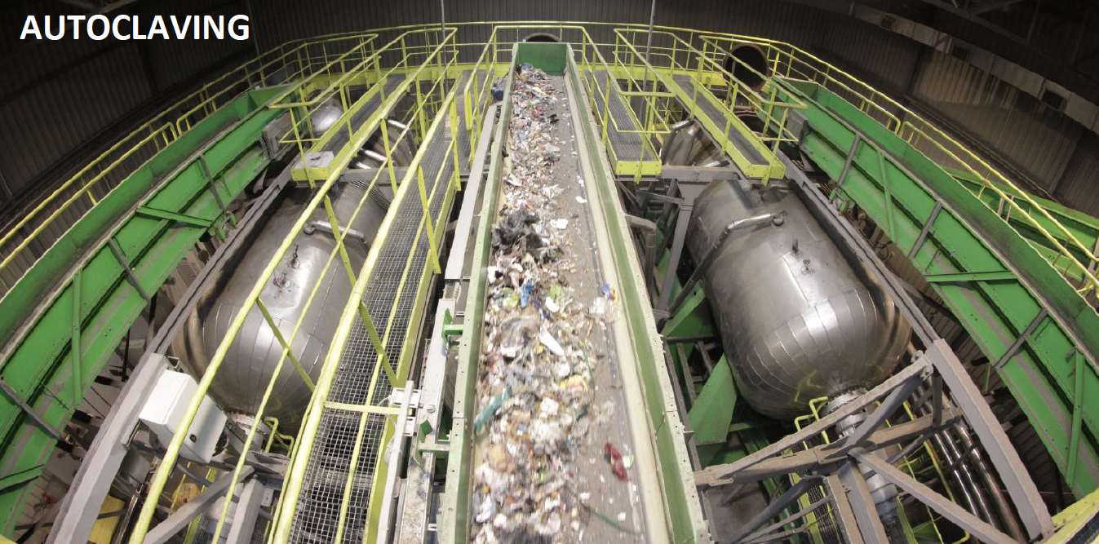
The shredded waste is placed into an autoclave and “cooked” with steam at a temperature of about 150 degrees Celsius and a pressure up to 3 bars.
Notes:
The shredded waste is placed in an autoclave and the hatch is closed. Using steam, the temperature is brought up to about 150 degrees Celsius and the pressure up to 3 to bars. It remains there for three hours.

Slide 17
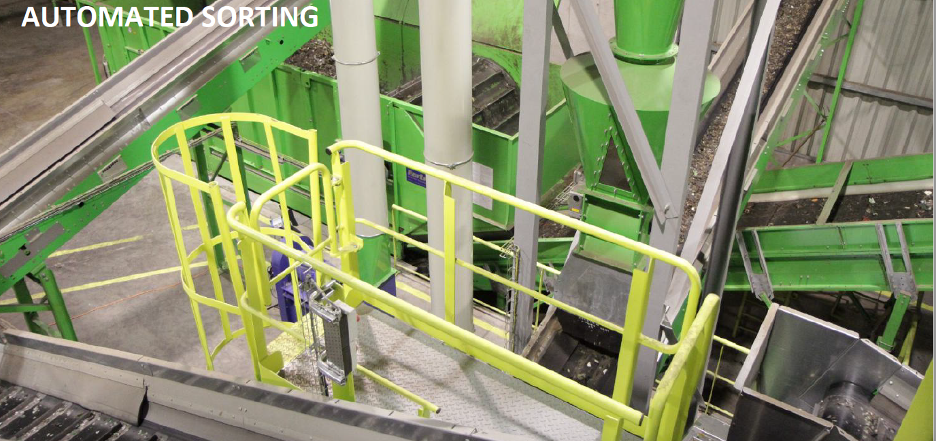
The sterilized waste is then automatically sorted. Recyclable materials such as glass, metal and plastics are diverted at a rate exceeding 90 percent.
Notes:
The sterilized waste is then dumped out to a conveyor, releasing sterile steam and reducing the mass of the waste by about 15 – 17 percent and the volume by 60 percent. Pathogens and odors are removed.
Plastics, glass and metals are cleaned, labels and printing removed.
Sterilization makes it easier to sort the waste, with rates exceeding 90 percent efficiency. Mechanical, optical, air and magnetic systems are used, with no need for hand sorting. All fractions remain sterile.

Slide 18
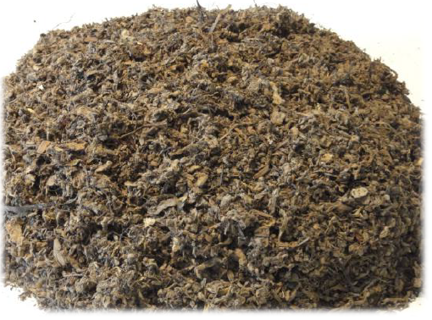
The automatic sorting system also removes biomass, mostly the organic, biodegradable waste, including paper.
The biomass is sterile and odorless, with a calorific value of 12 MJ/kg as a dry mass.
It is suitable as a fuel source for heating plants.
Notes:
The system also sorts out biomass, an organic, biodegradable waste, suitable as a fuel source for heating plants.

Slide 19
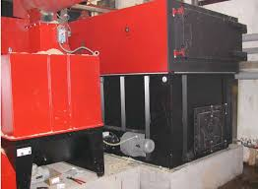
Khmelnytskyi currently operates communal heating districts that burn biomass pellets and natural gas.
These plants could be augmented to use sterilized biomass.
Notes:
Some of the biomass and RDF can be used to fuel the plant’s internal steam boilers.
Surplus biomass could be used as a fuel in its district heating plants. These plants currently are licensed for biomass from alternative energy sources. Some already burn biomass pellets and others burn expensive natural gas.

Slide 20
A 5 hectare site just 1.1 kilometers from the landfill has been identified and plans are now underway for its purchase and rezoning.
Notes:
A site has been identified. The selling is willing and plans are underway for a change in zoning and purchase. There are no residential areas within the 500 meter sanitary zone. It is located just 1 kilometer away from the existing landfill.

Slide 21
Other project elements include:
Diverting Construction Waste (CW)
Composting Leaf & Yard Waste (L&YW)
Upgrading to a “full cost accounting” system
Promoting source separation of Household Hazardous Waste (HHW)
Notes:
Important, but less central elements of the project include:
Diverting Construction Waste (CW)
Upgrading to a “full cost accounting” system
Promoting source separation of Household Hazardous Waste (HHW)

Slide 23
Notes:
No new landfills – and over 90 percent diversion rate
Maximizes the recycling of materials and the recovery of energy
Does not require source-separation
A circular economy and reuse of materials
A model for Ukrainian MSW management
A demonstration that municipal governments can execute large infrastructure projects
A safe, efficient, modern and reliable method of MSW management for Khmelnytskyi for many years to come.

